Slide 1
Problem statement-3 Pothole Detection System for Road Maintenance and Accident Prevention
Team Name: StackUnderFlow from PES UNIVERSITY, Bangalore Team Members: Ria Treza Serrao
Kristal Joanne D’souza
Aayudh Bhattacharya
Andre Aditya Roy

Slide 2
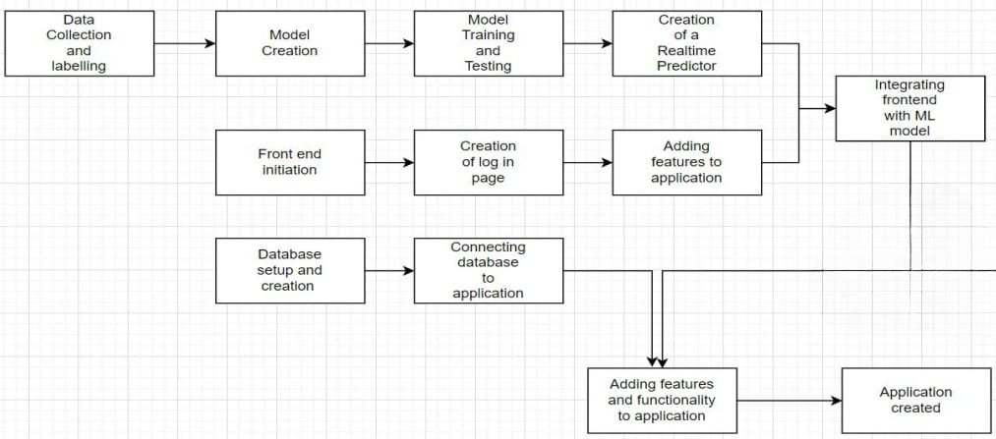
Abstract and scope
● Our project aims to solve one of the biggest problems for the roads in India which is potholes and the inconveniences that come with it and targets to find a new, reliable and creative solution to address the issues linked with potholes
● Our approach to solve this problem is by making an Android application that will serve as an interface for the users.
Users can log in to the application and detect potholes by allowing access to the camera. The phone must be fixed on the dashboard so that the application can detect the potholes by using the camera and also alert the user.

Slide 3
Proposed Approach / Methodology
Camera and Real-time Pothole Detection:OpenCV for Android To process camera frames and detect potholes in real-time.
Accelerometer, Gyroscope inbuilt in phones -accelerometer data can help you determine the impact or shock experienced when the vehicle hits a pothole, while gyroscope data can provide information about the orientation of the device during the impact.
Backend (Firebase):For login data and timestamps.
Frontend built using React Native
Camera Integration:Use Expo Camera API to access the smartphone camera.Continuously capture images or video frames while the app is running in the background
Pothole Detection Algorithm:Using a CNN model to detect potholes in real-time. Converting CNN .h5 model to .tflite model for mobile deployment.
Results Obtained: Trained CNN model which detects potholes in real time with an accuracy of 87-90%.

Slide 4

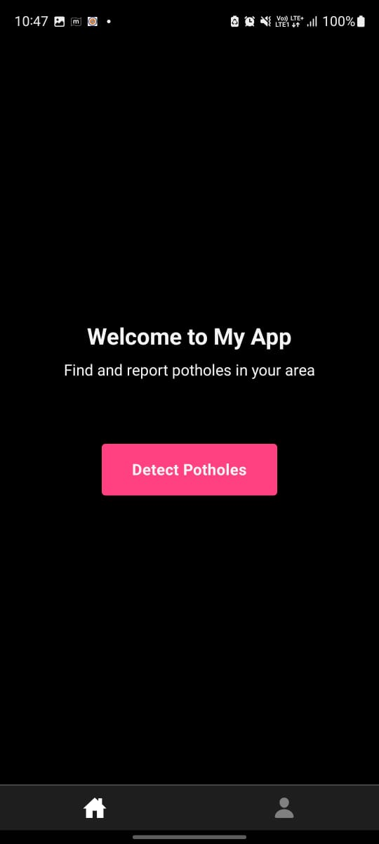

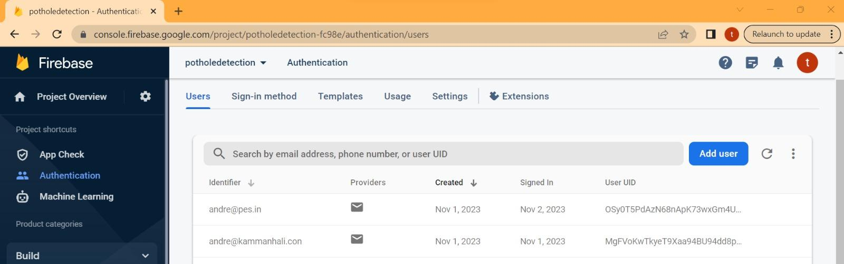
Real time detection demo
https://drive.google.com/drive/folders/14qQhNVRzQBMIm2iZriPnN8aTdjPWgOzy

Slide 5
Conclusions
● Potholes can have several negative consequences, such as posing safety hazards for drivers and pedestrians, increasing road maintenance costs, causing vehicle damage, and contributing to traffic congestion and environmental harm. Our Android application combines real-time camera analysis, machine learning, and user-friendly features to offer a new, creative, and dependable solution for combating potholes. By leveraging Firebase for user data and timestamps, our solution addresses the technical and practical aspects of this problem comprehensively. Future prospects include integration of google maps API for accurate coordinates. Our ultimate goal is to significantly improve road safety and reduce inconveniences associated with potholes, making daily commutes and travel more reliable and efficient for all road users in India.

